Slide 1




Population genetics and data analysis in R programming language
Dr. Shankar Kaji Shakya
Botany and Plant Pathology
Oregon State University, USA

Slide 2

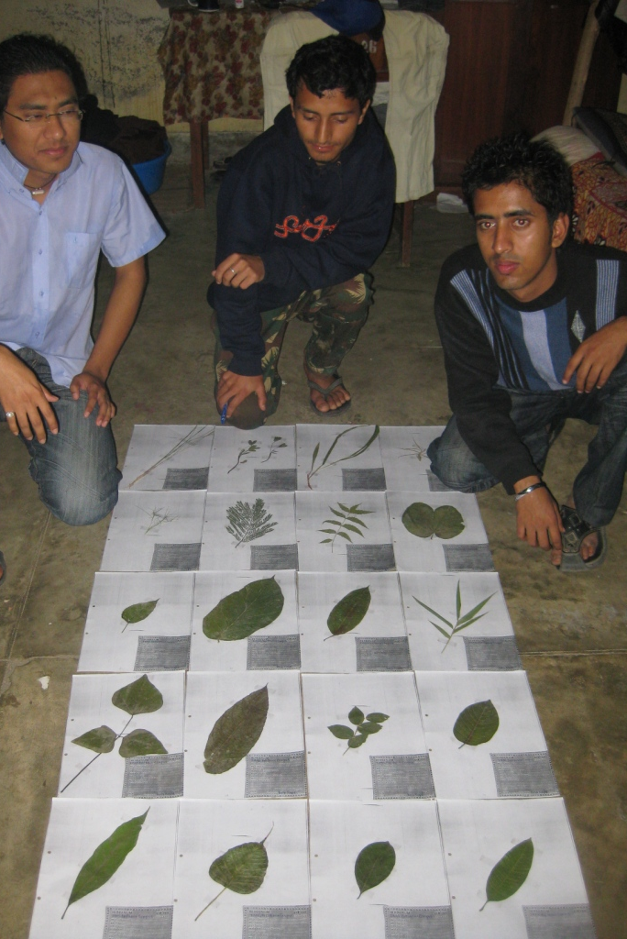
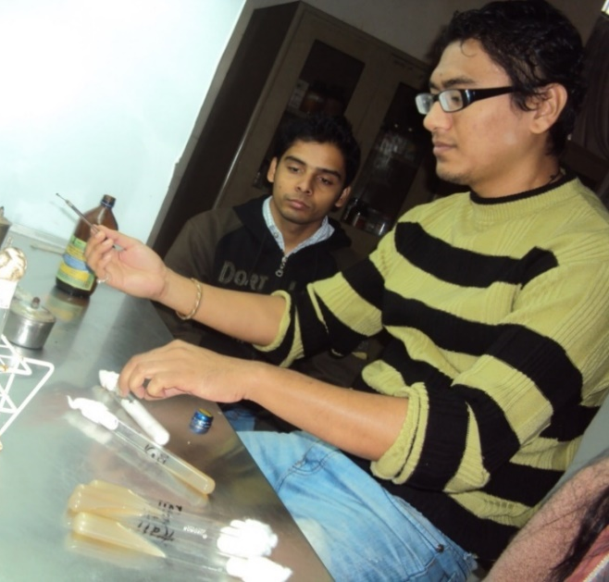
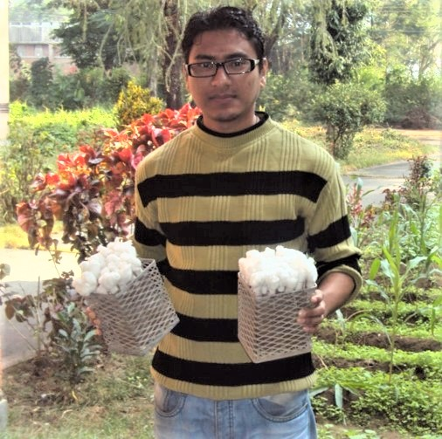
B.S. Plant Pathology
Tribhuwan University, Nepal (2006-2010)

Slide 3

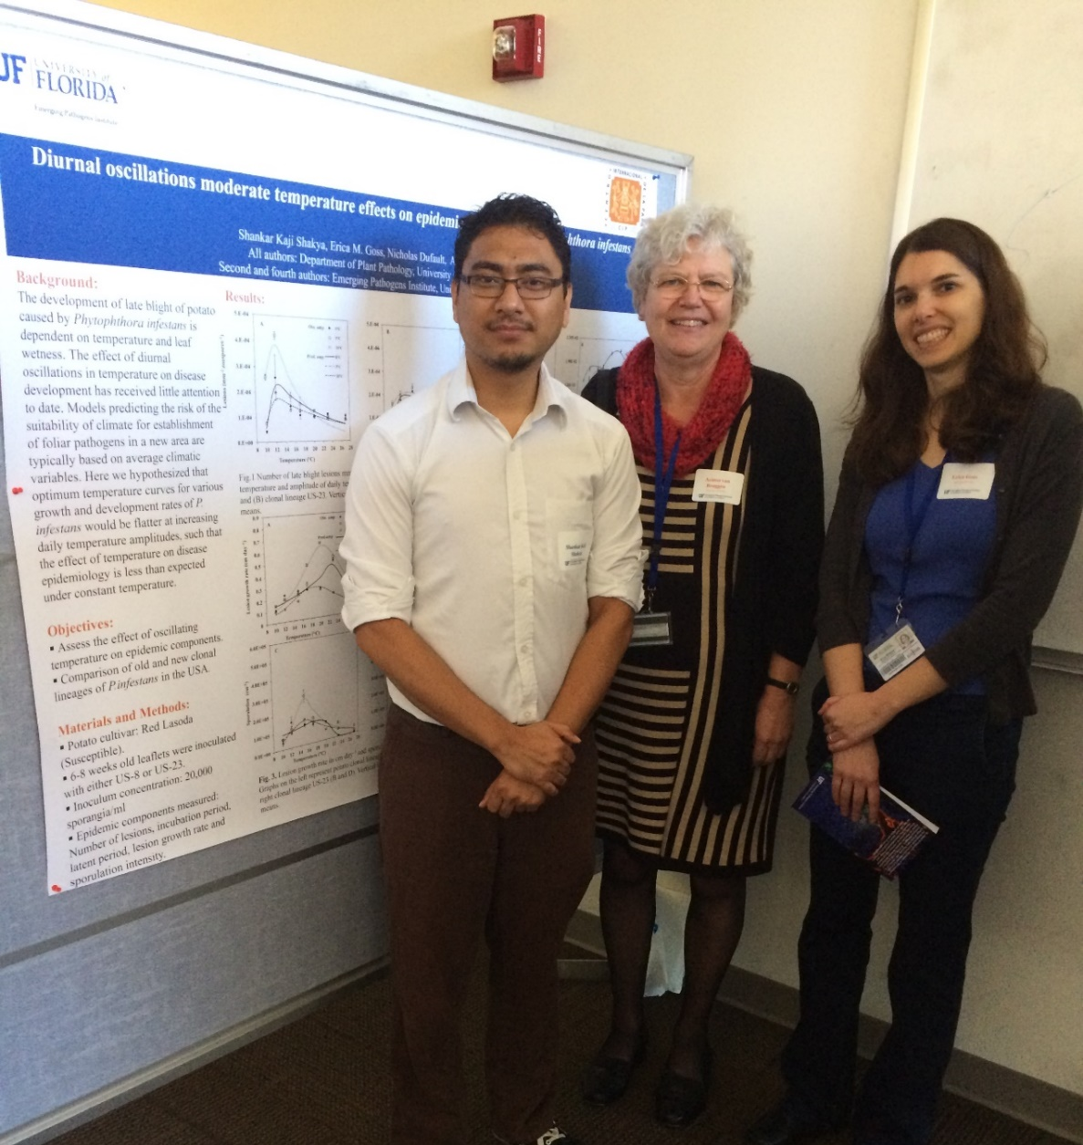
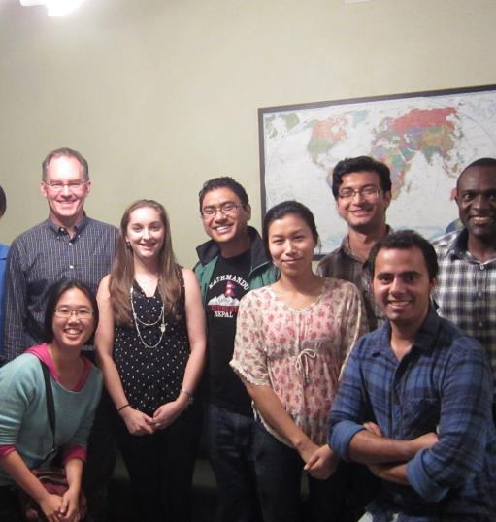
M.S. Plant Pathology
University of Florida (2012-2014)

Slide 4

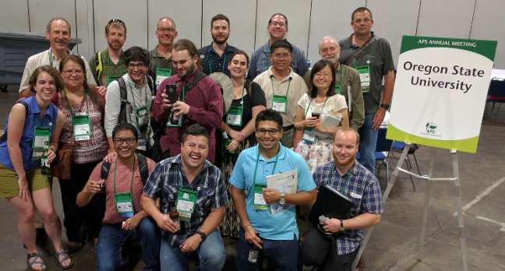
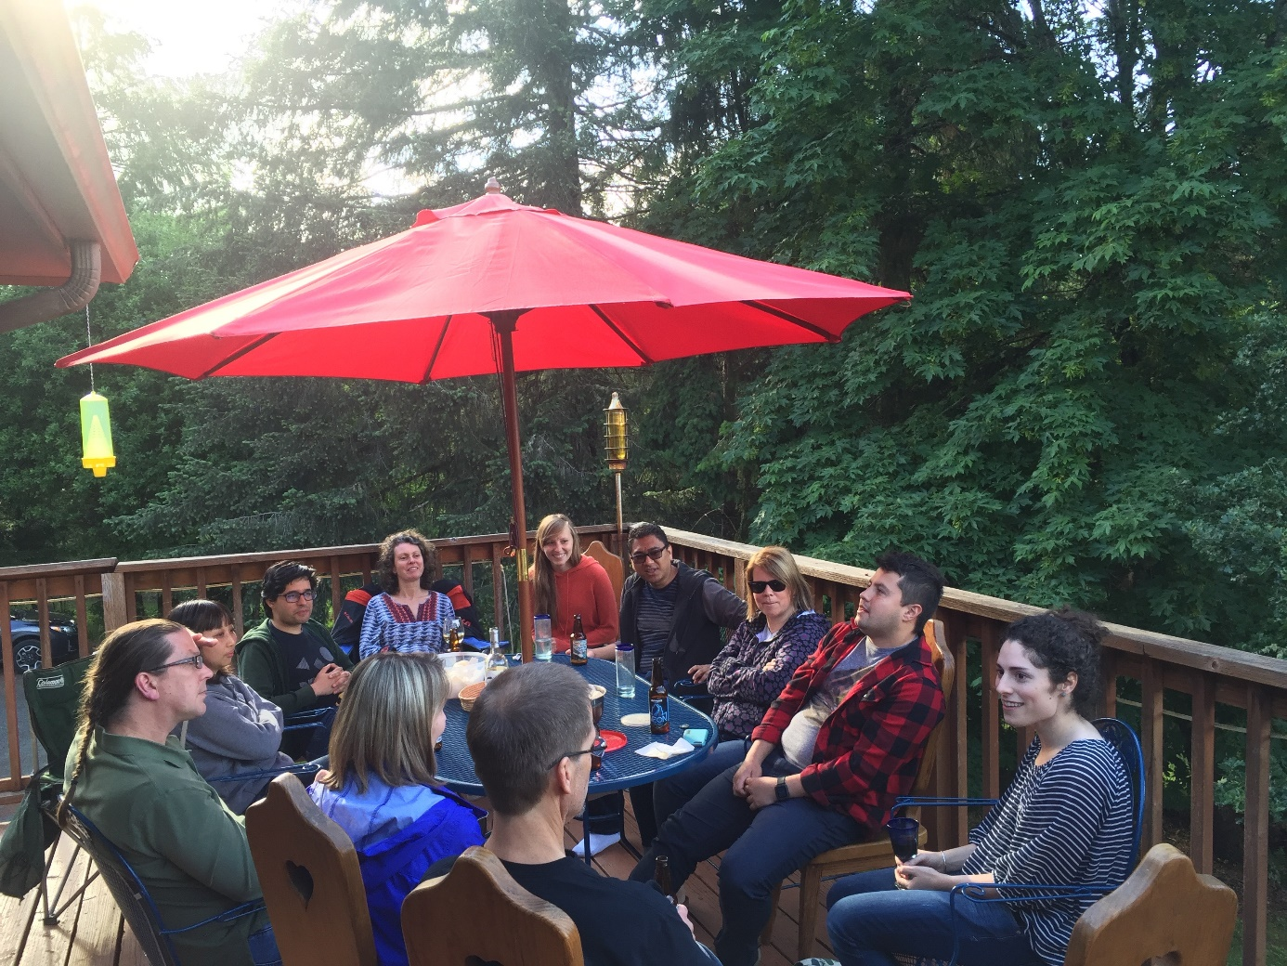
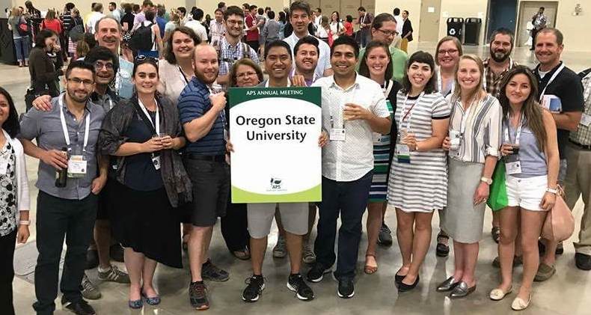
Go Beavs!!

Slide 5
Information about workshop
This will be a 2.5 day workshop
Each day 10 am - 4 pm with appropriate breaks
We will learn 3 things in this workshop
What is population genetics?
What is R and R programming?
How to analyze population genetics data in R?
Be respectful

Slide 6
Overall outline:
Day 1: Lecture on introduction to population genetics, Hardy Weinberg equilibrium, microsatellite markers, population structure and clustering.
Day 2: R and Rstudio, data analysis in R and plotting.
Day 3: Microsatellite data analysis in R (Shakya et al. 2018) and certificate distribution

Slide 7
Now lets make a group of 4 people

Slide 8
Day 1 : Intro to population genetics
Study of genetic composition of the population and forces that cause changes in this composition. Simply, it is also the study of forces like mutation, migration, selection and drift. Before diving into details, there are some key concepts that we need to learn.
Locus (plural loci): Position in a genome where one or more alleles are segregating.
ATGC………………………………………………………….
From nucleotide to genome

Slide 9
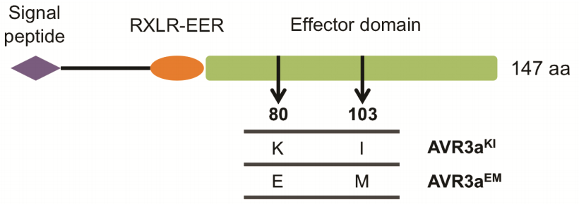
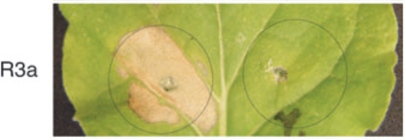
Allele: It is a variant form of a gene
Avr3a^{KI} triggers hypersensitive response but not Avr3a^{EM}
Isoforms of Avr3a
Avr3a^{KI} Avr3a^{EM}
Bos et al. 2006, The Plant Journal

Slide 10
Genotype: Genotype is the combination of the alleles at a particular locus.
If an individual has same allele at a locus, we call that homozyogous individual e.g AA or aa If an individual has different allele at a locus, we call that heterozygous individual e.g Aa
Allele frequency: Frequency of copies of the allele in the population divided by total number of gene copies in the population.
Genotype frequency: Number of individuals of certain genotype divided by total number of individuals.

Slide 12
Hardy Weinberg equilibrium

Slide 15
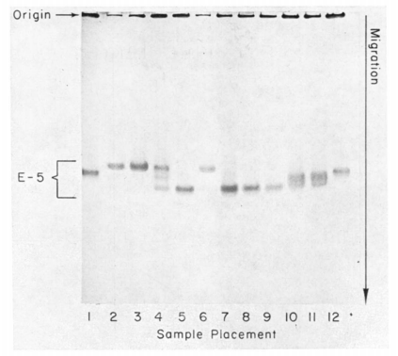
Measure of genetic variation
A molecular approach to the study of genic heterozygosity in natural populations. I. The number of alleles at different loci in Drosophila pseudoobscura.
J. L. Hubby and R. C. Lewontin
Genetics, 1966
Allozyme electrophoresis

Slide 16
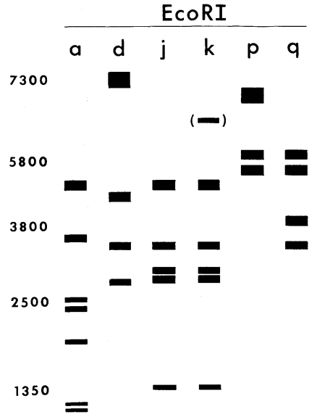
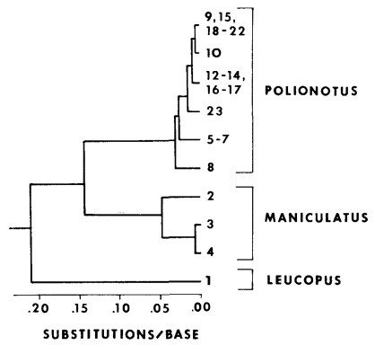
Measure of genetic variation
Restriction enzyme analysis
mt DNA tree
Avise et al. 1979, Genetics

Slide 17
Measure of genetic variation
Microsatellites/SSRs: regions of the genome with repeating sequences of two to six base pairs.
e.g. GTAGTAGTAGTAGTA (tri nucleotide repeat)
Advantage:
Codominant transmission (heterozygotes distinguished
from homozygotes).
Highly polymorphic and easily genotyped.

